Slide 1
Donald Norman The Father of Human-Centered Design

Slide 2
Who is he?
Born 1935, American cognitive scientist & usability expert.
Worked at Apple (VP of Advanced Technology).
Co-founder of Nielsen Norman Group.
Professor at UC San Diego and Northwestern University.

Slide 3
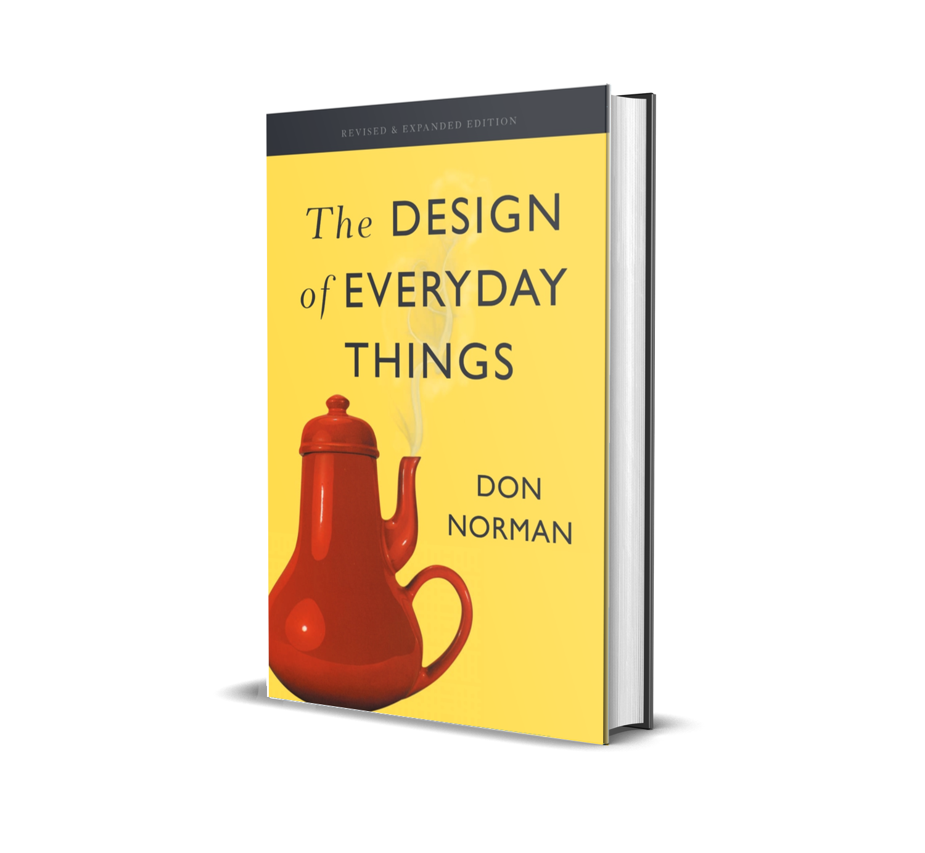
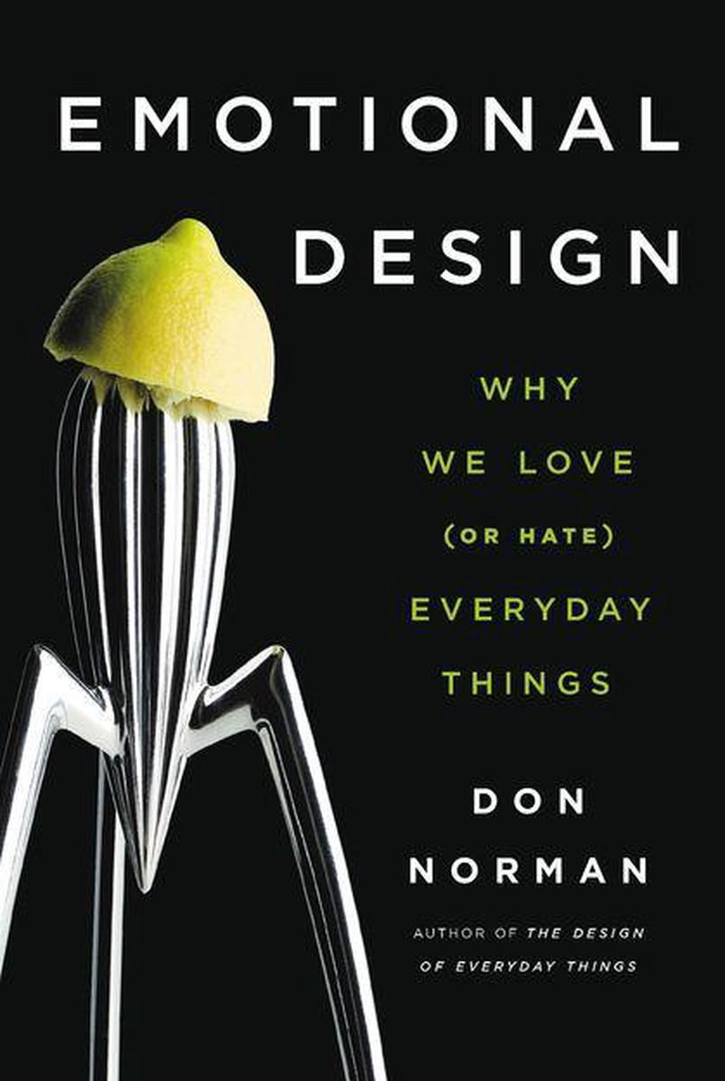
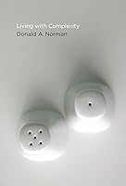
Books

Slide 4
Design Principles
Affordances → What actions are possible.
Signifiers → Clues to guide use.
Constraints → Prevent mistakes.
Feedback → Clear responses to actions.
Mapping → Intuitive control-effect relationship.

Slide 5
Everyday Life
A door with a flat metal plate that looks like it should be pushed, but actually needs to be pulled.
- Principle: Poor signifiers (handle/plate doesn’t match intended action).
- Why it matters: Causes constant user errors.
A row of 5 identical switches, but no labels — you don’t know which one controls which light.
- Principle: Lack of mapping (controls don’t match effects).
- Good Design: Switches arranged in the same layout as the lights they control.
Microwave oven with overly complex keypads with dozens of buttons (popcorn, pizza, beverage, reheat, etc.).
- Principle: Too much complexity without clarity.
- Good Design: Simple interface with clear time/power buttons and feedback (like a dial or touchscreen).
A remote with 50+ tiny, identical buttons, most of which people never use.
- Principle: Overloaded affordances with poor constraints.
- Good Design: Streaming remotes (like Roku/Apple TV) with fewer, clear buttons.

Slide 6
More Everyday Life
Fancy hotel faucets with no clue how to turn on water (twist, push, lift?) or adjust temperature.
- Principle: Missing signifiers and poor affordances.
- Good Design: Clear handles labeled hot/cold with intuitive motion.
USB-A cables that only go in one way, but you often try the wrong way first.
- Principle: Poor constraints and no clear signifier for orientation.
- Good Design: USB-C — works both ways.
Car touchscreen-only climate control → you have to look away from the road to adjust temperature.
- Principle: Lack of physical affordances and bad feedback.
- Good Design: Knobs and dials you can adjust by feel.
Automatic dispensers that don’t sense your hand properly (waving around awkwardly).
- Principle: Inconsistent feedback.
- Good Design: Clear motion response with consistent output.
Crosswalk buttons that many don’t actually work (placebo buttons). Users press, but nothing changes.
- Principle: Misleading feedback.
- Good Design: Audible and visible confirmation when the button is pressed.

Slide 7


Slide 8

“Design is really an act of communication, which means having a deep understanding of the person with whom the designer is communicating.” — Donald Norman

